Slide 1
Chapter 13: Advanced topic 3 Web 3.0

Slide 2
Contents
Web 3.0
Metadata
RDF
SPARQL
OWL

Slide 3
Web 3.0
Web 1.0
  Website publish information, user read it
  Ex:
Web 2.0
  User create content: post information, modify, delete them
  Ex: YouTube, Flick
Web 3.0, next web generation
  Semantic web (or the meaning of data), personalization (e.g. iGoogle), intelligent search based on behavioral of users.
    Search for information for user with a request in nature form (a complex sentence)
    different users obtain deferent search result
  Ex:iGoogle
Web 3.0 is defined as the creation of high-quality content and services produced by gifted individuals using Web 2.0 technology as an enabling platform.

Slide 4
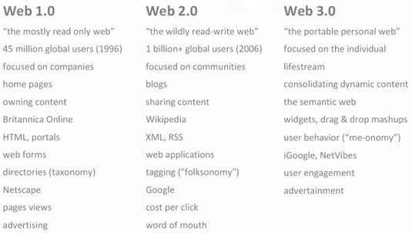
Web 3.0

Slide 5
Web 3.0
Technique for Web 3.0
  Base on user profile: his behavior and habit.
    Search information for user based on his profile → different users obtain deferent results
  Using API provided by Web 2.0 site. Ex: API of Facebook
    Programming and access to data of websites through their API
  Mashup
  a web page or application that uses and combines data, presentation or functionality from two or more sources to create new services
  Ex: website using Google Maps and Wikipedia API

Slide 6
Semantic Web
Semantic Web is an evolving development of the Web in which the semantics of information and services is defined
  web is able to understand and satisfy the requests of people and machines to use the web content.
Semantic web comprises of a variety of enabling technologies for formally describing concepts, terms, and relationships within a given knowledge domain
    RDF: Resource Description Framework
    OWL: Web Ontology Language
    SPARQL
    …

Slide 7
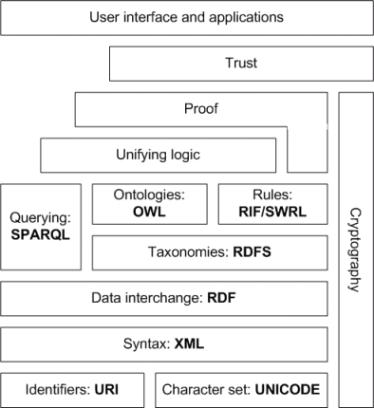
Semantic web stack
XML provides an elemental syntax. No semantics.
XML Schema is a language for providing and restricting the structure and content of elements contained within XML documents.
RDF is a simple language for expressing data models, which refer to objects ("resources") and their relationships. An RDF-based model can be represented in XML syntax.
RDF Schema is a vocabulary for describing properties and classes of RDF-based resources, with semantics for generalized-hierarchies of such properties and classes.
OWL adds more vocabulary for describing properties and classes, relations between classes (e.g. disjointness), cardinality (e.g. "exactly one"), equality, richer typing of properties, characteristics of properties (e.g. symmetry), and enumerated classes.
SPARQL is a protocol and query language for semantic web data sources.

Slide 8
Metadata
Metadata is information about data within an application or environment
Metadata commonly defines the structure or schema of the primary data.
Ex:
  metadata would document data about
    data elements or attributes, (name, size, data type, etc)
    data structures (length, fields, columns, etc)
    data (where it is located, how it is associated, ownership, etc.).
  Metadata may include descriptive information about the context, quality and condition, or characteristics of the data.
Metadata is used to facilitate the understanding, usage, and management of data, both by human and computers

Slide 9
Metadata
Examples:
  Meta data of a digital photograph includes
    date and time at which it was created
    details of the camera settings (such as focal length, aperture, exposure).
    resolution
    Many digital cameras record metadata in their digital images, in formats like exchangeable image file format (EXIF) or JPEG.
  Meta data of an audio file
    Sampling ratings
    Encoding
    Audio Format
    …
  Meta data of an XML file: Its XML schema or DTD
  Meta data of an RDF file: RDF schema.
  Meta data of a video recording
    Director, filmer, actor, summary of the contents, length of the recording, critical rating, and the data and source of this recording …

Slide 10
RDF
Resource Description Framework (RDF) is a family of W3C specifications originally designed as a metadata data model.
RDF is used as a general method for conceptual description or modeling of information that is implemented in web resources;
RDF uses a variety of syntax formats.

Slide 11
RDF
RDF is based upon the idea of making statements about Web resources, in the form of subject-predicate-object expressions → triples.
  subject denotes the resource,
  predicate denotes traits or aspects of the resource, expresses a relationship between the subject and the object.
  Ex,
    "The sky has the color blue" in RDF is as the triple: a subject denoting "the sky", a predicate denoting "has the color", and an object denoting "blue".
A collection of RDF statements represents a labeled, directed multi-graph
  →more naturally suited to some kind of knowledge representation than the relational model and other traditional ontological models.
  In practice, RDF data is often persisted in relational database or native representations also called Triplestores, or Quad stores.
RDF is an abstract model with several serialization formats (i.e., file formats)
RDF turn enabling users to deal with the information with greater efficiency and certainty.
Abstract concepts of RDF has led to its increasing use in knowledge management applications unrelated to Semantic Web activity.

Slide 12
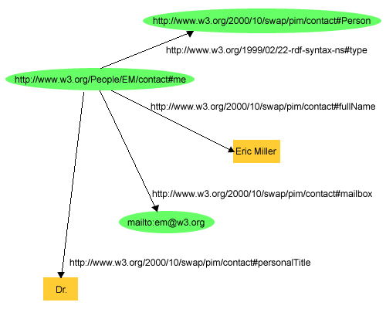
RDF example (directed graph)
RDF Description of a person named Eric Miller

Slide 13
RDF example (triple)
<http://www.w3.org/People/EM/contact#me>
<http://www.w3.org/1999/02/22-rdf-syntax-ns#type>
<http://www.w3.org/2000/10/swap/pim/contact#Person>
<http://www.w3.org/People/EM/contact#me>
<http://www.w3.org/2000/10/swap/pim/contact#fullName>
“Eric Miller”
<http://www.w3.org/People/EM/contact#me>
<http://www.w3.org/2000/10/swap/pim/contact#mailbox>
<mailto:em@w3.org>
<http://www.w3.org/People/EM/contact#me>
<http://www.w3.org/2000/10/swap/pim/contact#PersonalTitle>
“Dr.”

Slide 14
RDF example (XML)
<?xml version="1.0"?>
<rdf:RDF xmlns:rdf="http://www.w3.org/1999/02/22-rdf-syntax-ns#"
xmlns:contact="http://www.w3.org/2000/10/swap/pim/contact#">
<contact:Person rdf:about="http://www.w3.org/People/EM/contact#me">
<contact:fullName>Eric Miller</contact:fullName>
<contact:mailbox rdf:resource="mailto:em@w3.org"/>
<contact:personalTitle>Dr.</contact:personalTitle>
</contact:Person>
</rdf:RDF>

Slide 15
XML syntax for RDF (1)
An RDF Document consists of an RDF element whose namespace is http://www.w3.org/1999/02/22-rdf-syntax-ns#
  <rdf:RDF xmlns:rdf=“http://www.w3.org/1999/02/22-rdf-syntax-ns#”>
    ...
  </rdf:RDF>

Slide 16
XML syntax for RDF (2)
The rdf:Description element makes a statement about a resource.
  <rdf:Description rdf:about="http://www.w3.org/People/EM/contact#me”>
    ...
  </rdf:Description>

Slide 17
XML syntax for RDF (3)
Within a description, the property is used as a tag, and the content is the value of the property.
  <rdf:Description rdf:about="http://www.w3.org/People/EM/contact#me”>
    <contact:fullName>Eric Miller</contact:fullName>
  </rdf:Description>

Slide 18
XML syntax for RDF (4)
The rdf:resource attribute indicates that the property element’s value is another resource.
  <rdf:Description rdf:about="http://www.w3.org/People/EM/contact#me”>
    <contact:fullName>Eric Miller</contact:fullName>
    <contact:mailbox rdf:resource="mailto:em@w3.org"/>
  </rdf:Description>

Slide 19
XML Syntax for RDF (5)
For description elements with a typing element, we can use the type name instead of rdf:Description.
  <contact:Person rdf:about="http://www.w3.org/People/EM/contact#me”>
    <contact:fullName>Eric Miller</contact:fullName>
    <contact:mailbox rdf:resource="mailto:em@w3.org"/>
  </contact:Person>

Slide 20
XML syntax for RDF (6)
Container elements are used to collect a number of resources.
  rdf:Bag – an unordered container.
  rdf:Seq – an ordered container.
  rdf:Alt – a set of alternatives. Typical examples are the document home and mirrors, and translations of a document in various languages.

Slide 21
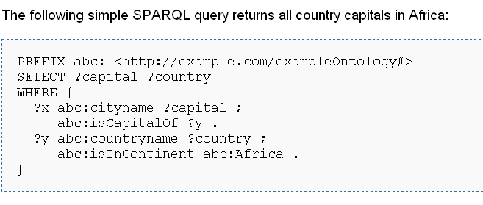
SPARQL
Dominant query language for RDF graph
SPARQL Protocol and RDF Query Language
SPARQL allows for a query to consist of triple patterns, conjunctions, disjunctions, and optional patterns.
Implementations for multiple programming languages exist

Slide 22
OWL
The Web Ontology Language (OWL) is a family of knowledge representation languages for authoring ontologies which is based on two semantics:
  OWL DL and OWL Lite semantics are based on Description Logics, which have attractive and well-understood computational properties, while
  OWL Full uses a novel semantic model intended to provide compatibility with RDF Schema.
OWL ontologies are most commonly serialized using RDF/XML syntax.
OWL is considered one of the fundamental technologies underpinning the Semantic Web, and has attracted both academic and commercial interest.

